Slide 1
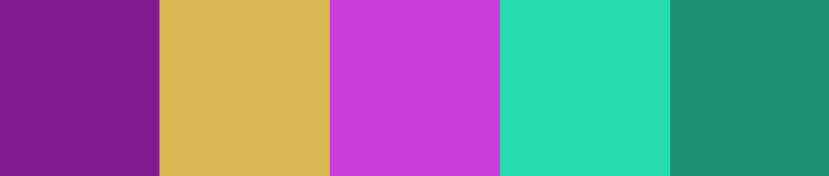
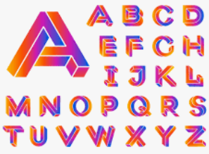
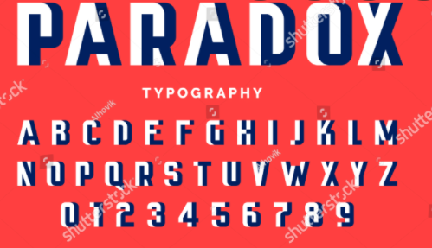
Mood board

Slide 2
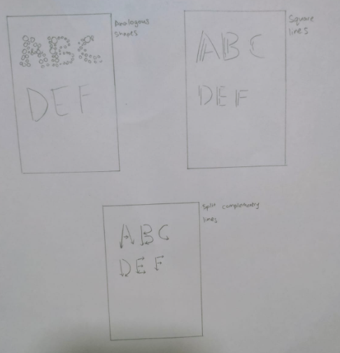
3 sketches
The first sketch was wanting to many circles and semi circles to make up the word to make it feel more artistic with purple colour and with a colour harmony of analogous nearing purple colour
The second sketch was to make glowing lines to make it feel more futuristic/modern and multiple lines to make up the alphabet itself with square colour harmony contain bright colours together to make it look neon
The third sketch was by making up with arrows which symbolise by how people usually write the strokes when writing an alphabet with a colour harmony of split complementary

Slide 3
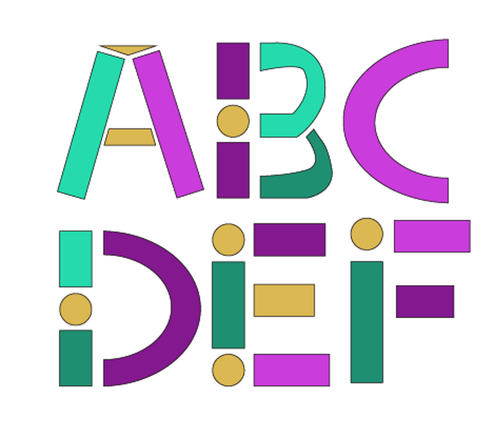
Final work

